Slide 1

Haptic Interface in a networked virtual environment
Pirmin, Pepijn, Derk & Chevan

Slide 2
Inleiding
Intro
Vorige sprint
Resultaten
Retrospective
Volgende sprint

Slide 3
Intro
TNO Military Cloud-Based Simulation Research Program
VR in netwerk omgeving
Grafieken/data gebruikers ervaring
Simulation Centre Royal Netherlands Army R&D
Haptic in netwerk omgeving
Grafieken/data gebruikers ervaring
MVP (minimal viable product)
DEMO VR & Haptic in netwerk omgeving

Slide 4
Vorige sprint
2. Use an actual VR headset for the application
14. Users get haptic feedback
9. multiplayer feature implementation
13. Users can connect from all over the world

Slide 5
2. Use an actual VR headset for the application
Tasks:
Aquire a quest 3 to work with
Implement the VR camera in a Unity project
Acceptence criteria:
If we move the vr headset, the camera in 'game' should also correspond to the same movement

Slide 6

2. Use an actual VR headset for the application (DEMO)
This image was generated using DALL·E, an AI-powered image generation tool developed by OpenAI.

Slide 7
14. Users get haptic feedback
Tasks:
Implement the haptic device in Unity
Decide what the haptic feedback will be (Building/terrain elevation)
Implement the actual haptic feedback
Acceptance criteria:
The user can feel the difference between the height of different buildings or terrain

Slide 8

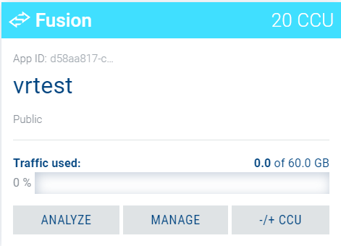
9. multiplayer feature implementation
Tasks:
Setup the pun2 server
Create a lobby/room system in custom unity world
Set up synced VR world and actions between Players
Implement this in The Hague terrain
Acceptance criteria:
Two clients using two VR headsets can connect to the same environment and see each other

Slide 9
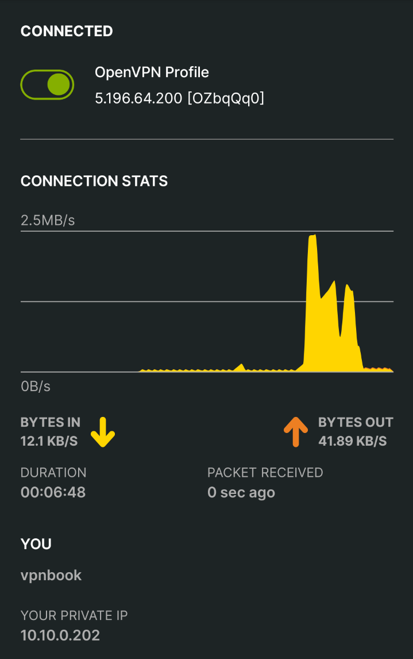
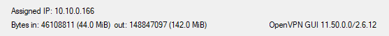
13. Users can connect from all over the world
Tasks:
Figure out what type of connection to use
Test the connections from different locations
Acceptance criteria:
A user can from country A connect to the server in Country B, this can be tested by using a VPN connection between the server and client

Slide 10
Documentatie
Deliverables documenteren met onderzoeksrapport, gebruikersrapport en evalutierapport.
Uitzoeken welke bronnen gebruikt zullen worden
Overige deliverables in kaart brengen (testplan, changelogs, etc.)

Slide 11
Retrospective
Afwezigheid bij ziek zijnde moeilijk optijd te melden
Vergeetachtigheid (Sprint, Feedback) --> Scrum master

Slide 12
Volgende Sprint
9. Multiplayer Feature Implementation
14. Users get haptic feedback
20. Haptic & VR user experience

